Slide 1
OOP in C#

Slide 2
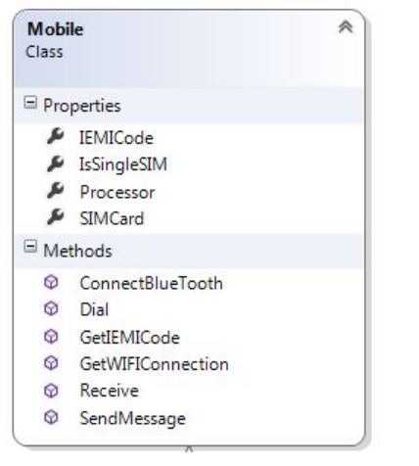
Class

Slide 3
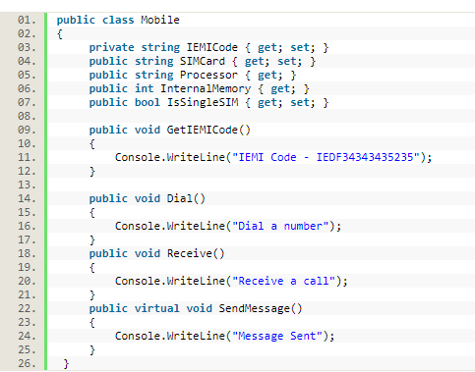
Class – Cont’d

Slide 4

Object
Instance of the blueprint provided by a class

Slide 5
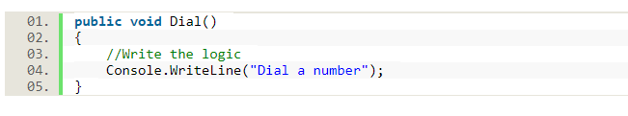
Abstraction
What happens when we click the dial button on a phone?
Sends a signal to the receiver’s mobile but we do not know how.

Slide 6
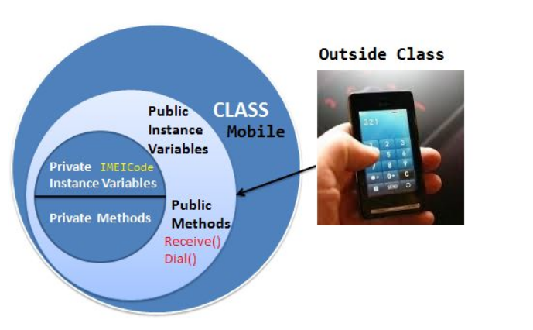
Encapsulation

Slide 7
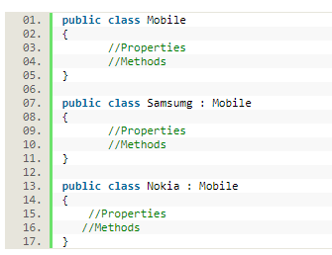
Inheritance

Slide 8
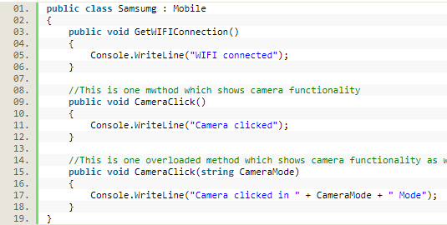
Polymorphism - Static

Slide 9
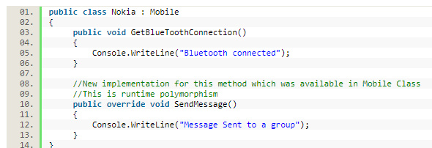
Polymorphism - Dynamic

Slide 10
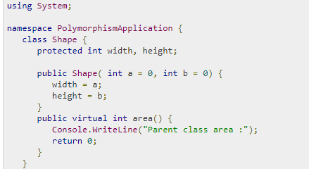
Polymorphism – Cont’d

Slide 11
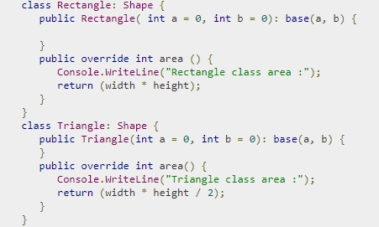
Polymorphism – Cont’d

Slide 12
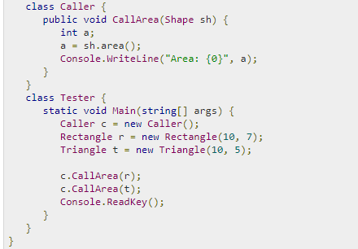
Polymorphism – Cont’d

Slide 13
Interface
Skeleton of classes
Enforce implementation of methods
Multiple interface can be implemented by the same class.

Slide 14
Questions?

